Slide 1
Basics Accounting Terms
Capital
Drawings
3. Liabilities
4. Assets

Slide 2
5. Receipts
6. Expenditure
7. Expenses
8. Income
9. Profit
10. Gain
11. Loss
12. Purchases
13.Purchases Return (Return outward)/ Return Cr.
14. Sales
15. Sales Return (Return inward)/ Return Dr.
16. Goods

Slide 3
17. Stock/ Inventory 23. Trade Payables
18. Debtors/ Account Receivable
19. Creditors/ Account Payables
20. Discount
A. Trade discount
B. Cash discount
21. Bad Debts
22. Trade Receivables

Slide 4
1. Capital: Capital is the amount invested by the proprietor or partner in the business.
Capital= Assets – Liabilities
Ex. Ram invested Rs 10,00,000 in the business. Capital Rs 10,00,000
2. Drawings: It is the amount withdrawn or goods taken by the proprietor or partner for personal use. Goods so taken by the proprietor are valued at purchase cost. At the time of preparing Balance sheet, it is deducted from capital.
3. Liabilities: Liabilities mean amount owed (payable) by the business.
Liability towards the owners of the business is termed as internal liability. Capital is also called internal liability.

Slide 5
continue
On the other hand, liability towards the outsiders, i.e., other than the owners is termed as external liability.
External liability arises because of credit transactions or loan taken. e.g. Creditors, bank overdraft, long term borrowings, loan etc
External liabilities or liabilities divided into two types:
(i) current liability (short term liability) eg. Creditors, Bank overdraft
(ii) Non current liability (long term liability) eg. Loan

Slide 6
Current Liability: it is that liability which is payable within 12 months from the end of the accounting period.
Eg. Creditors, bills payable, short-term loans, outstanding expenses, advance income, Account Payable etc.
Non –current liability: Non-current liability is that liability which is payable after a period of more than a year from the end of the accounting period.eg long term loans, loan, debentures etc

Slide 7
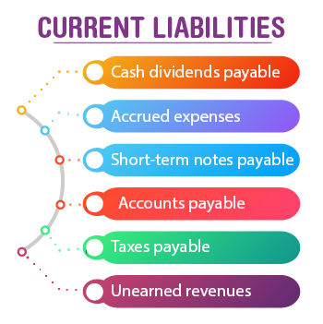

Slide 8
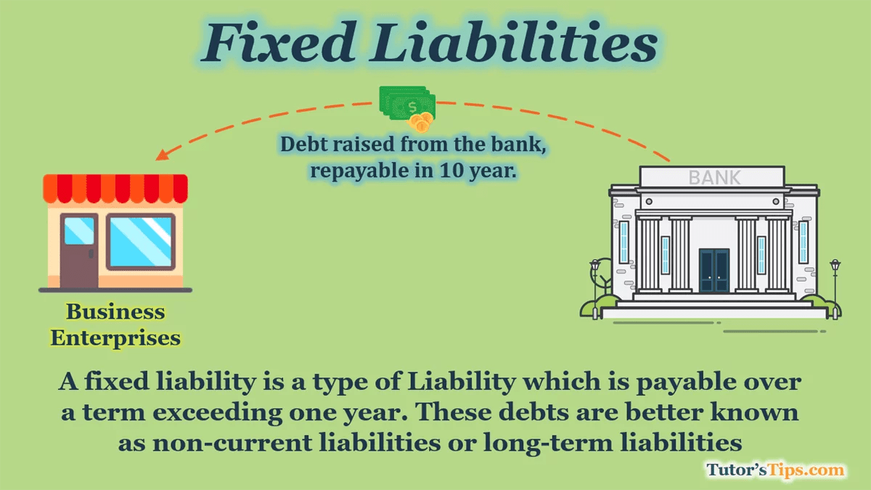

Slide 9
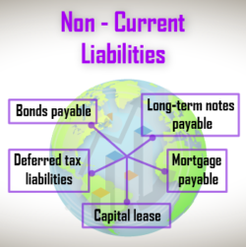

Slide 10
4. Assets: meaning:
Assets are properties ( tangible assets and intangible assets) owned by a business. They are the economic resources of the business.
In other words, anything which will enable the firm to get cash or an economic benefit in the future.
E.g. Building, Land, Machinery, Stock, Debtors, Cash and Bank balances, trademark, rights, goodwill etc
types of Assets:
(i) Current Assets
(ii) Non current Assets (Fixed Assets)
(iii) Fictitious Assets : Deferred Revenue Expenditure:
Preliminary exp.

Slide 11
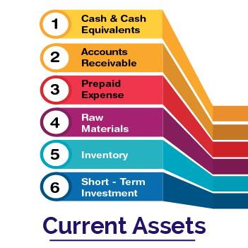

Slide 12
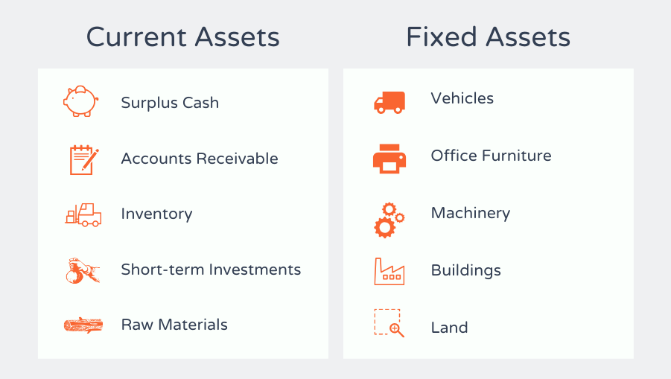

Slide 13
Current assets:
Current assets are those assets which are held by the business with the purpose of converting them into cash within a short period, i.e, one year. Eg. Cash, Bank, Debtors, Bills receivable, stock, prepaid expenses, accrued income etc.
Non Current Assets(fixed assets): Non – current assets are those assets which are held in the business for long term. These assets give benefit to the organisations in more than one accounting period.
Land & Building, Furniture, Investment etc.

Slide 14
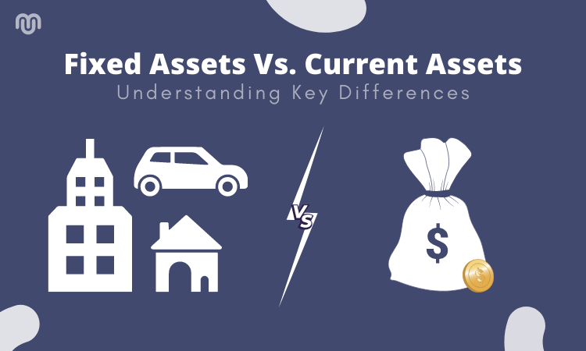

Slide 15
5. Receipts: It is the amount received or receivable for selling assets, goods or services.
2 types:
(i) Revenue receipts: it is the amount received or receivable in the normal course of business say against sale of goods or rendering of services. E.g. sale of goods, service revenue, interest on investment etc. It is treated as income. It is recorded in Trading a/c and Profit and Loss a/c (Income Statement)
(ii) Capital Receipts: it is the amount received or receivable against transactions which are not revenue in nature. Eg. Sale of Old machinery, loan taken etc. It is recorded in Balance sheet.

Slide 16
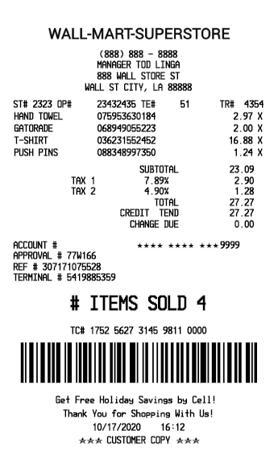

Slide 17
6. Expenditure:
It is the amount spent or liability incurred for acquiring assets, goods or services.
3 types:
(i) Capital expenditure: Purchase of Machinery (Fixed Assets)
(ii) Revenue expenditure: Rent paid ( regular nature)/ expenses
(iii) Deferred Revenue expenditure : Big amount of Advertising
(Fictitious assets)

Slide 18
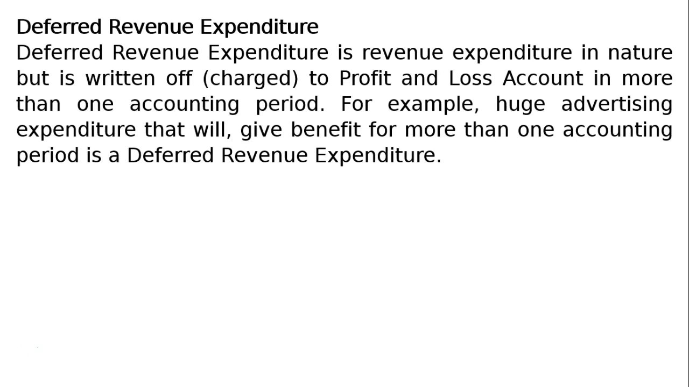

Slide 19
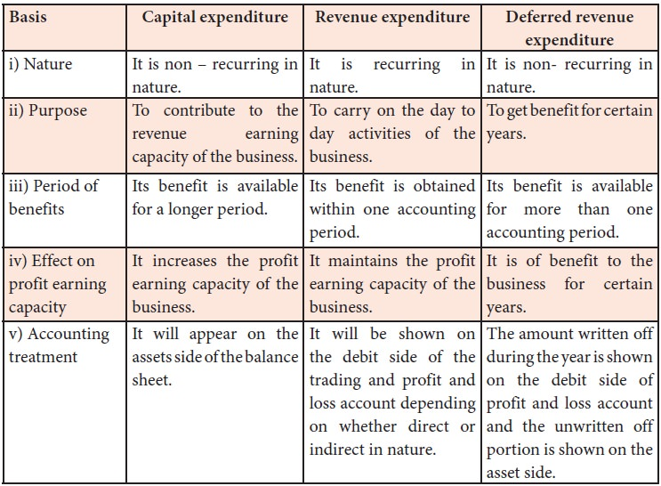

Slide 20
7. Expense: It is the cost incurred for generating revenue(income).
Eg. i.Cash payment such as salaries, wages
Ii. Depreciation, Bad debts
III. Cost of goods sold.
8. Income: Income is the profit earned during a period.
Income= Revenue – Expense
Income is also known as profit.

Slide 21
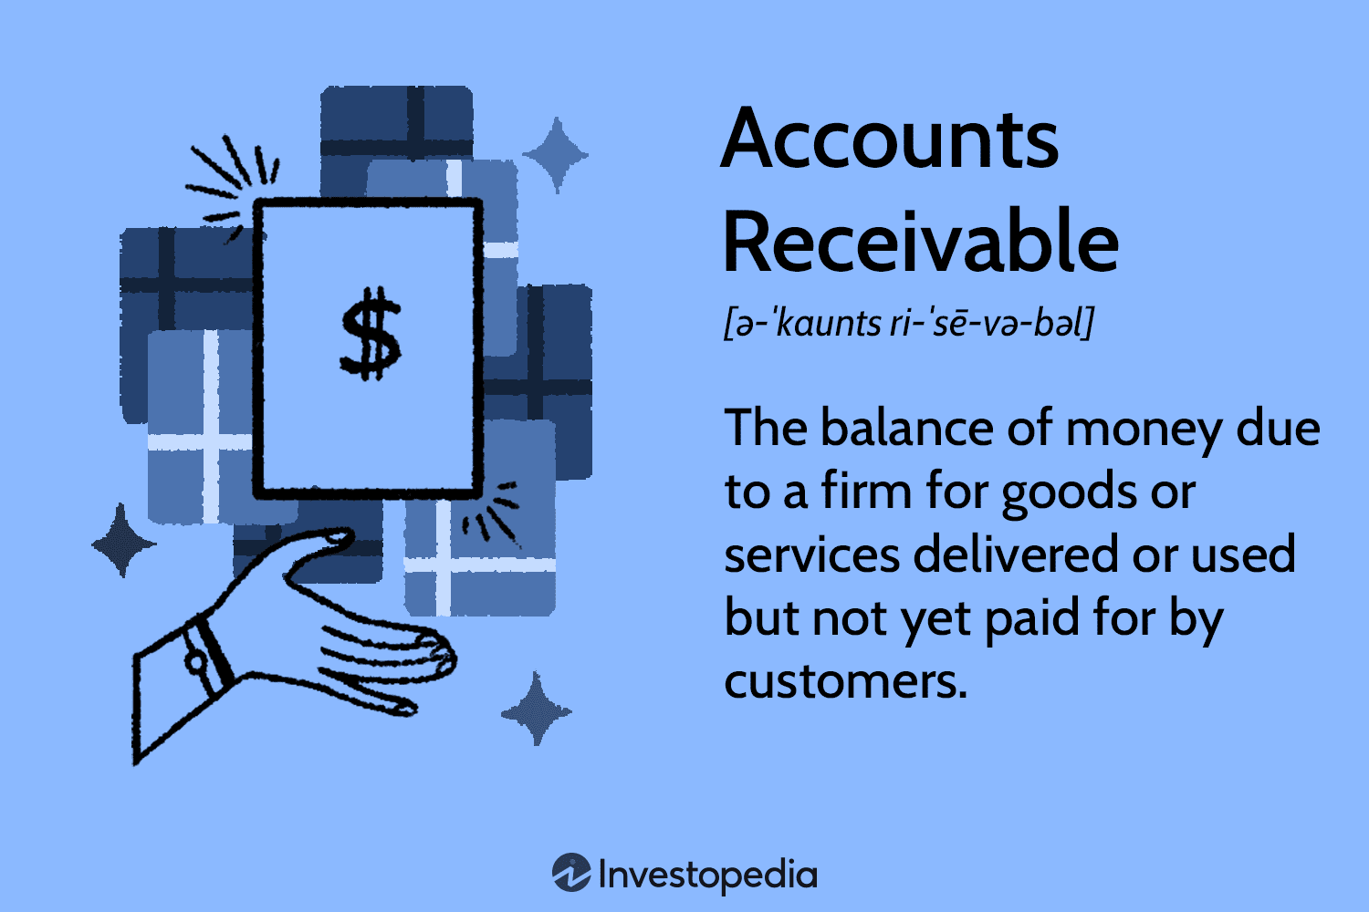

Slide 22
9. Debtor: Debtor is a person who owes amount to the enterprise against credit sale of goods or services in its ordinary course of business.
Eg. Goods sold to Ram Rs.10,000 on credit then Ram is Debtor.
Debtor is a type of assets are to be recorded in Balance sheet
Debtor is also called Account Receivable
Eg. Services performed on Account Rs 50,000 or Billed to client for services provided.
Account Receivable Dr
Service Revenue Cr

Slide 23
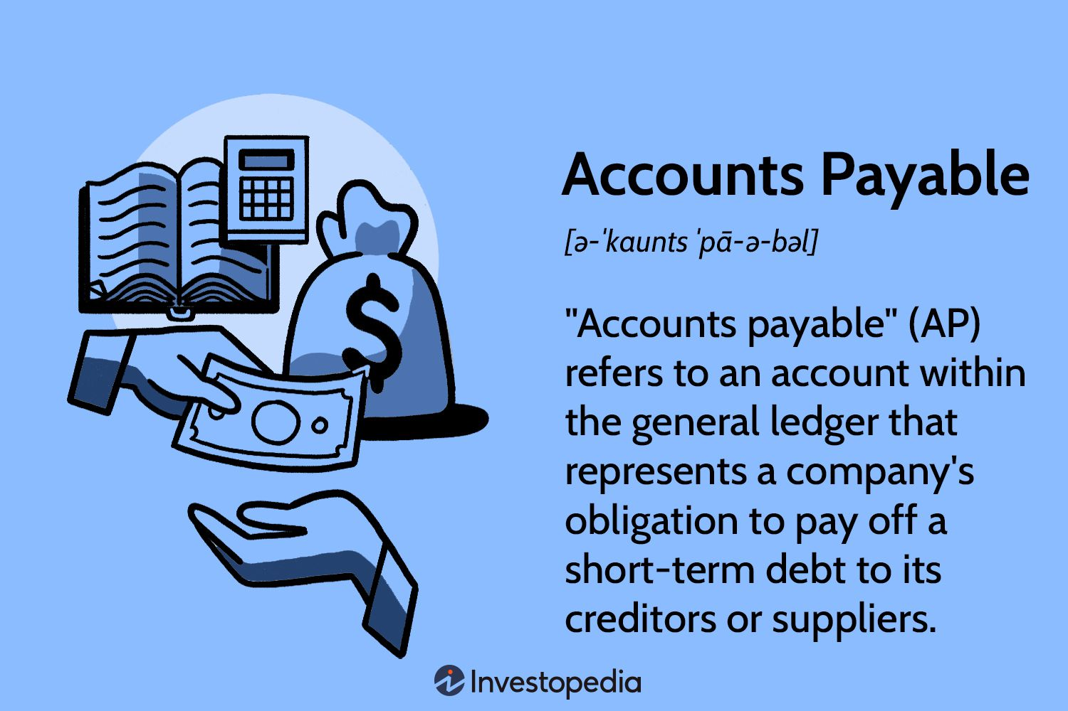

Slide 24
10. Creditor: Creditor is a person to whom an enterprise owes amount against credit purchases of goods or services taken.
Eg. If goods purchase on credit Rs 15,000 from Hari. Then Hari is creditor.
Creditor is a type of Liabilities. It is recorded in Balance sheet.
Creditor is also called Account Payable.
Goods purchased on Account/ Furniture Purchased on Account
Purchase/Furniture Dr
Account Payable Cr
11. Profit: Profit means income earned by the business from its Operating Activities, i.e., the activities carried out by the enterprise to earn profit. Gross profit & Net profit.

Slide 25
12. Gain: Gain is a profit of irregular nature. Gain on sale of fixed assets.
13. Loss: Loss is excess of expenses of a period over its revenues(incomes). Eg. Cash or goods lost, loss on sale of fixed assets.
Loss=Expenses- Revenue (Income)
= 10 lakh – 8 lakh = 2 lakhs
14. Purchase: The term ‘Purchase’ is used for purchases of goods for resale or for producing the finished products which are also to be sold. Cash Purchases & Credit Purchases. It is recorded on Dr side of Trading a/c.
15. Purchases Return: Goods purchased may be returned to the seller for any reason, say, they are defective. It is deducted from Purchase.

Slide 26
16. Discount: When customers are allowed rebate in the prices of goods by the business .
Trade discount: Trade discount is the rebate allowed by the seller on the basis of sales, either quantity or value.
Sales – trade discount=Net sales
Purchase – trade discount = Net Purchase
Trade Discount is not recorded in the books of Account.
Cash discount: Cash discount is the rebate allowed for timely payment of due amount. It is recorded in the books of Account.
Discount allowed (exp.), Discount received (income)

Slide 27
Bad Debts: Bad Debt is the amount owed to the business that is written off because it has become irrecoverable. It is a loss for business. It is recorded on Dr. side of Profit & Loss a/c.
Trade Receivables: It is the amount receivable for sale of goods or services rendered in the ordinary course of business. It is treated as Assets.
Trade receivables = Debtors + Bills receivable
Trade Payables: It is the amount payable for purchase of goods or services taken in the ordinary course of business. It is treated as Liabilities.
Trade Payables = Creditors + Bills Payables

Slide 28
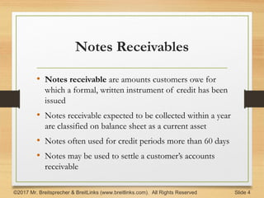

Slide 29
Notes Payables: It represents obligation to bank or other creditors based on formal written agreement. A specific interest rate is usually identified in the agreement.
Eg: Signed an 8%, Rs 1,00,000; 3 years note. Hence Notes payable – Rs 1,00,000
Accrued Income: The income that has been earned but cash is not receive is called Accrued income. It is type of Assets.
Prepaid Expenses: The expenses that have been made for the period beyond the accounting period. It is also called unexpired expenses.

Slide 30
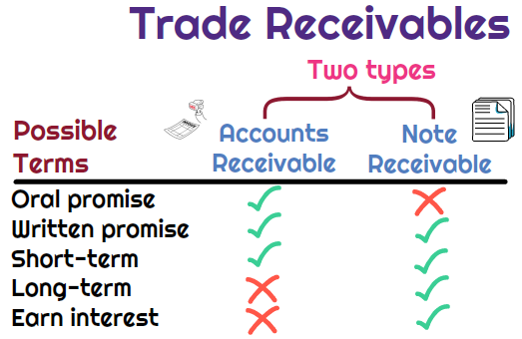

Slide 31
Imp.
What are the qualitative characteristics of accounting information? List out of them and explain in detail.
Explain the need of accounting information to different internal and external users of accounting information.
Financial accounting is not only concern with recording financial transactions but force to do ethical business. Justify this statement with accounting principles.
Discuss about various accounting concepts, accounting principles and accounting conventions.

Slide 32
5. Role of Accounting information System in modern business organizatons.

Slide 33
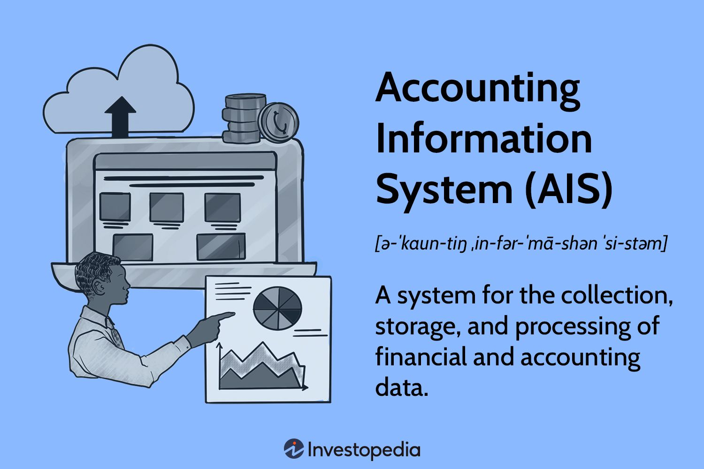

Slide 34
